Slide 1
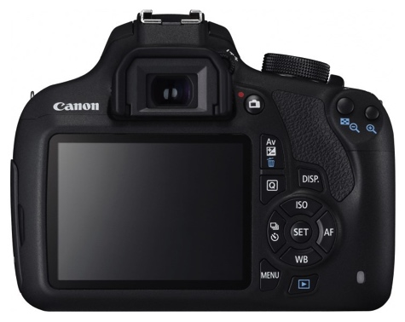
Label the DSLR Canon 1200
F R
Z R
L Focus M Switch
S Button
M Dial
F Button
P Switch
M Dial
L R Button
V
L Display
C K
P Button

