Slide 1
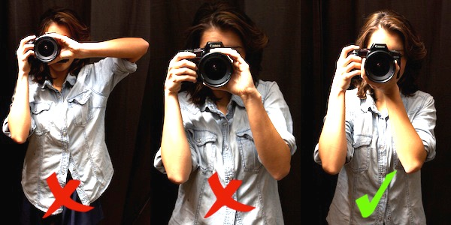
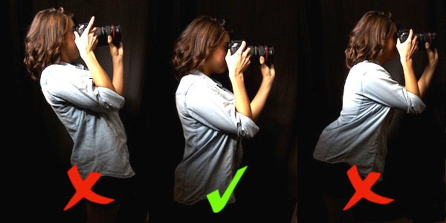
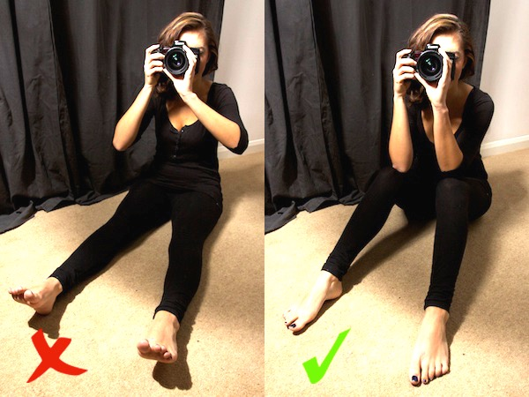
How to hold a camera
Put a tick beside the correct posture for each camera
position
Label and annotate the pictures above explaining
how to hold a camera correctly.

